Slide 1
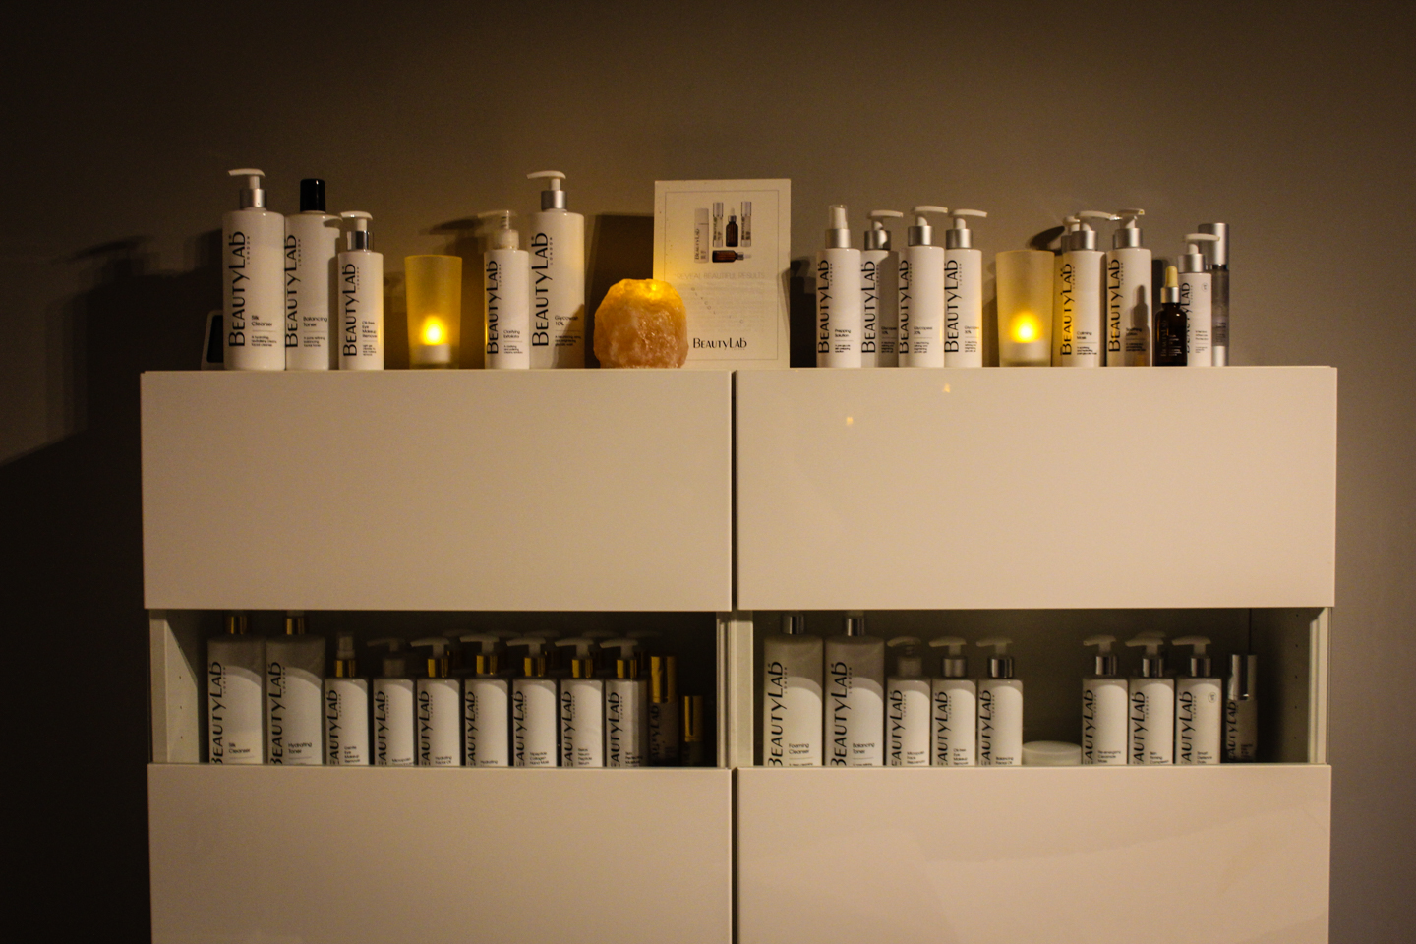
3 BeautyLab Facials for the price of 2
Treat your skin this Spring with three facials throughout April and May
1hr Glycolic Facial
“Resurfacing And Brightening”
Course of 3 facials for £130
Saving of £65!!
1hr Anti-Ageing Facial
“Firming and Smoothing”
Course of 3 facials for £120
Saving of £60!!
T’s & C’s Apply – All 3 facials must be taken in April/May 2019 and MUST be paid for in advance upon booking to be eligible for the 3 for 2 discount. Cannot be used with any other promotion or discount
Call us on 01932 874409
or pop by the salon to book this fabulous offer!
Please note *This course CAN’T be booked online*

